Slide 1
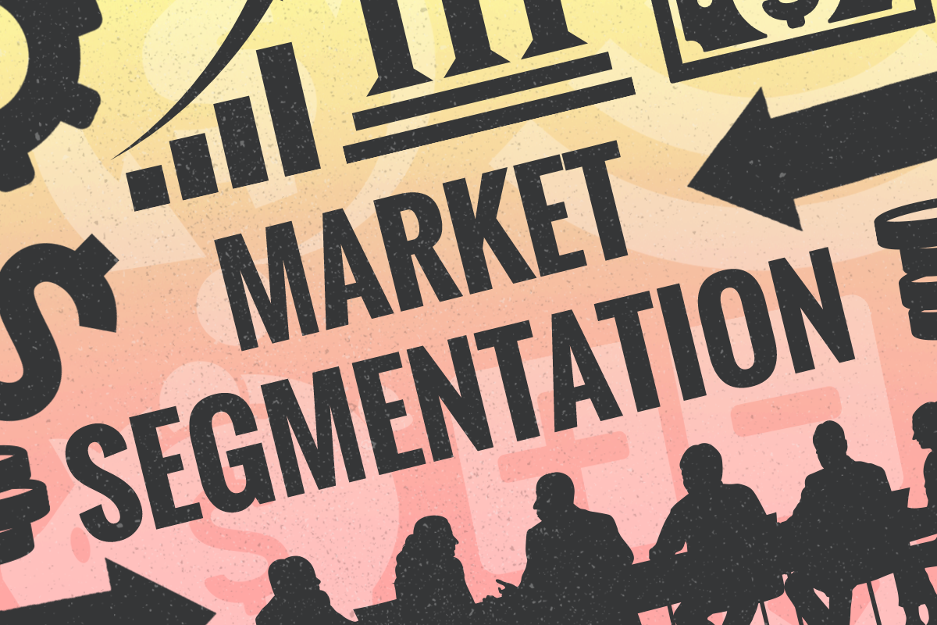

Slide 2
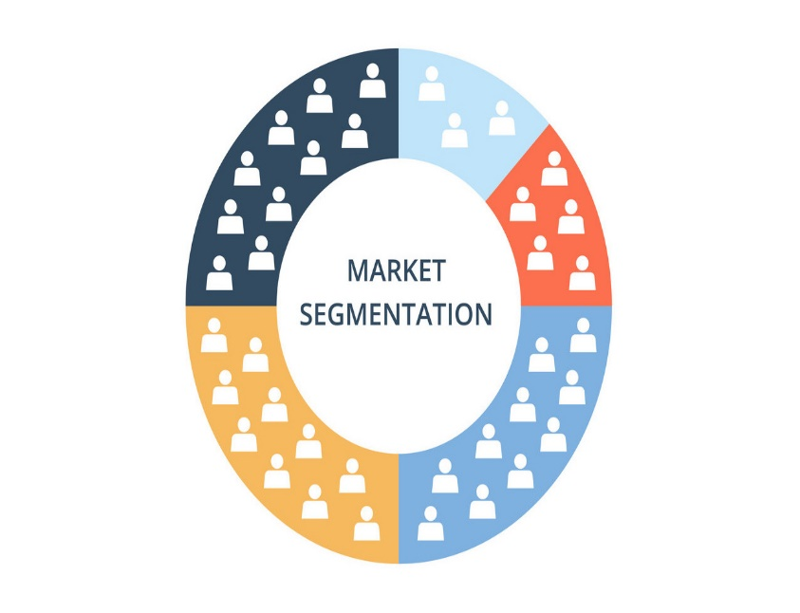

Basic market concepts
Market group of individuals who are potential customers for product being offered for sale
Market segments portions of a larger market
Market segmentation process of dividing a heterogeneous market into smaller number of more homogeneous customer groups, or market segments
Target market the market segment identified as being most likely to buy company’s product

Slide 3
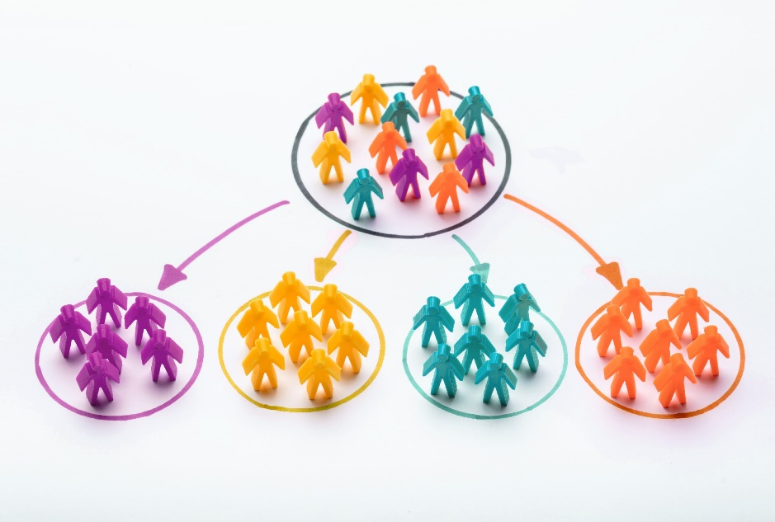
SEGMENTATION EXPLAINED
Segmentation is the division of the general market into smaller sub-markets so you can get closer to your customer than would otherwise be the case. Characteristics of viable segmentation are: 1 Customers within the segment have more in common with each other in terms of their needs for the product than they have with those customers or prospects outside the segment. 2 In the perception of customers or prospects in the segment, the company more closely addresses their needs than competitors do.

Slide 4
Levels of market segmentation
Micro level (individual customers)
Micro Marketing
Segmented marketing
Macro level (all customers)
Mass marketing

Slide 5
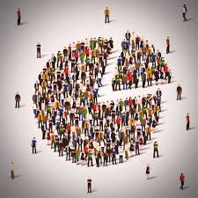
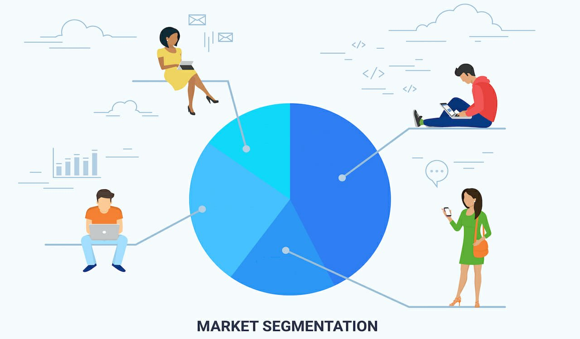
Effective segmentation
Measurable/identifiable which customers; how many?
Accessible through economical marketing efforts?
Substantial worth serving? Will they respond favourably to specialist mix?
Meaningful segments that have different preferences/needs and show variations in market behaviour/response to marketing efforts

Slide 6
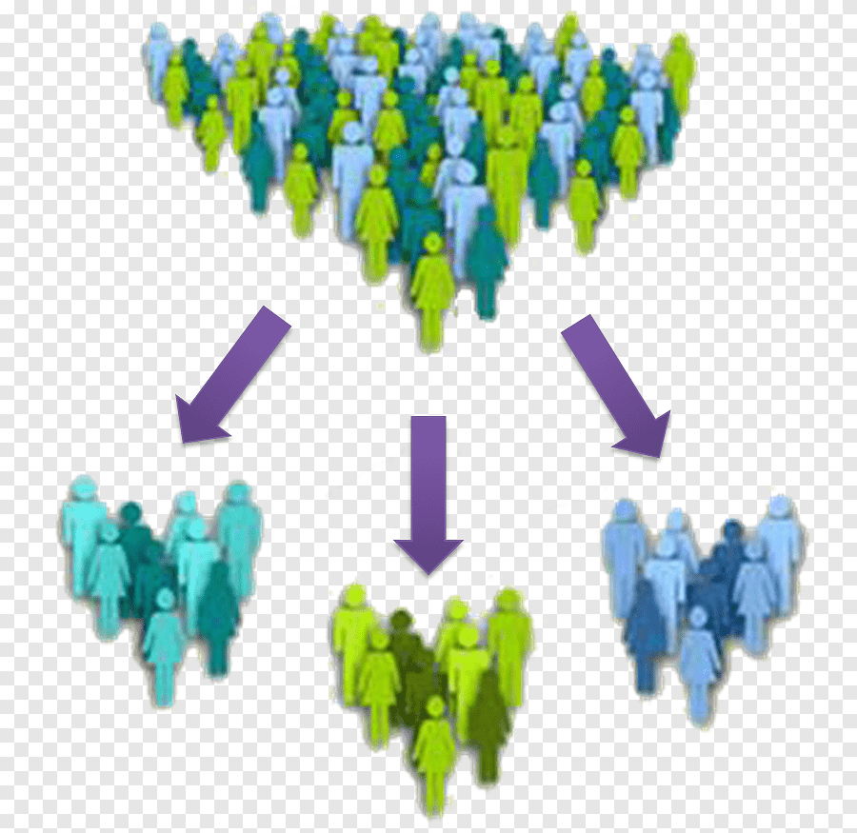
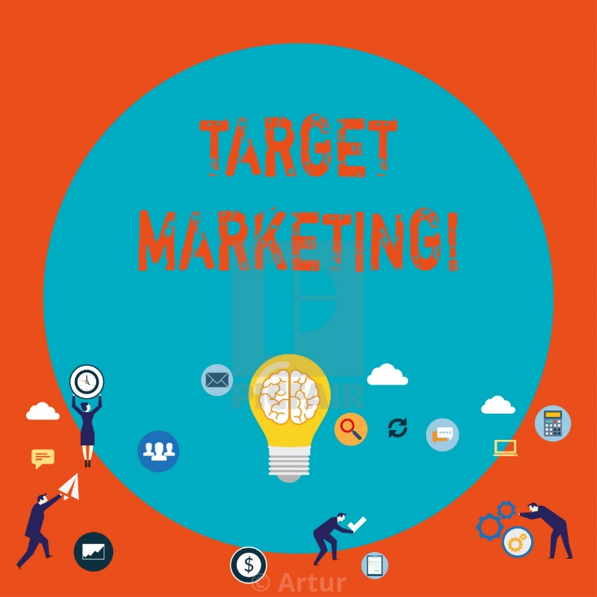
ADVANTAGES OF TARGET MARKETING
Marketing opportunities and ‘gaps’ in a market may be more accurately identified and appraised.
Product and market appeals (the marketing mix) can be more finely tuned to needs of potential customer.
Marketing effort can be focused on the market segment(s) which offer greatest potential for the company to achieve its objectives.
Individual customers
Market segments
Total market segmented into subgroups/segments
Total market ie no segmentation

Slide 7
Meaningful segmentation
Is there a characteristic that distinguishes the segment?
Is the market potential of adequate size?
Is the segment accessible through economical means?
Will the segment respond favourably to a specialised marketing mix?
Consider choosing this meaningful segment as a target market
yes
yes
yes
yes
No
No
No
No
The market segment is not meaningful

Slide 8
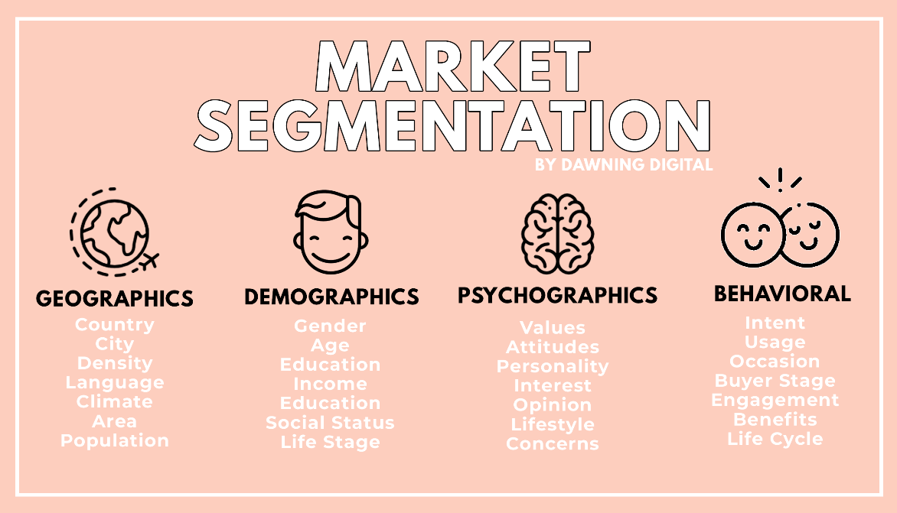
Bases for consumer market segmentation
Geographic
Demographic social class; age; sex; income; education; ACORN; family size; nationality; family life cycle
Lifestyle 4Cs i.e. Constrained (resigned poor, struggling poor); Middle Majority (mainstreamers, aspirers; succeeders); Innovators (traditionals, reformers); VALS system
Occasions for purchase user/usage status, benefits sought, loyalty status

Slide 9
Variables for Segmenting
Consumer
Markets

Slide 10
Demographic
Variables for Segmenting
Consumer
Markets

Slide 11
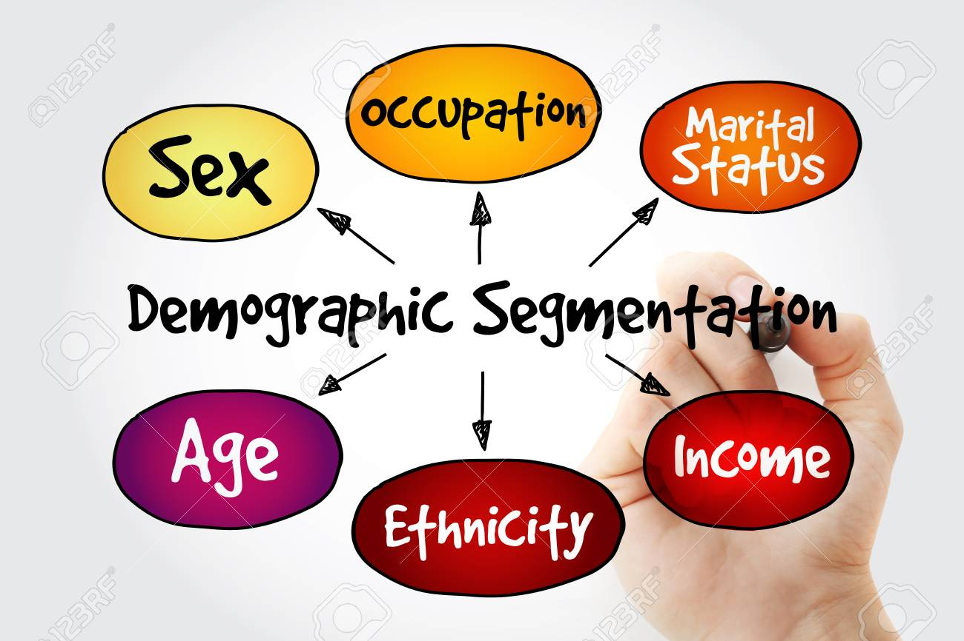
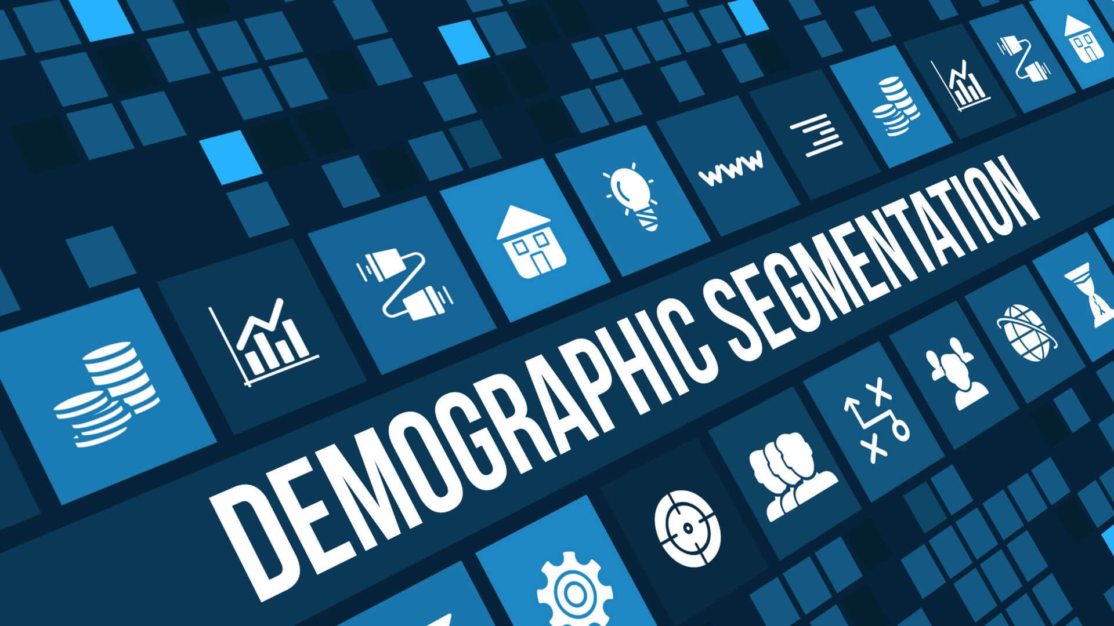
Detailed View of Demographic Variables
Age
Gender
Race
Ethnicity
Income
Education
Occupation
Family Size
Family Life Cycle
Religion
Social Class

Slide 12
Demographic
Geographic
Variables for Segmenting
Consumer
Markets

Slide 13
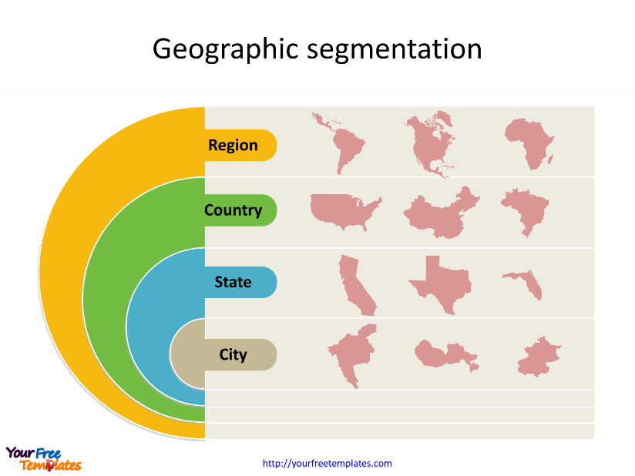
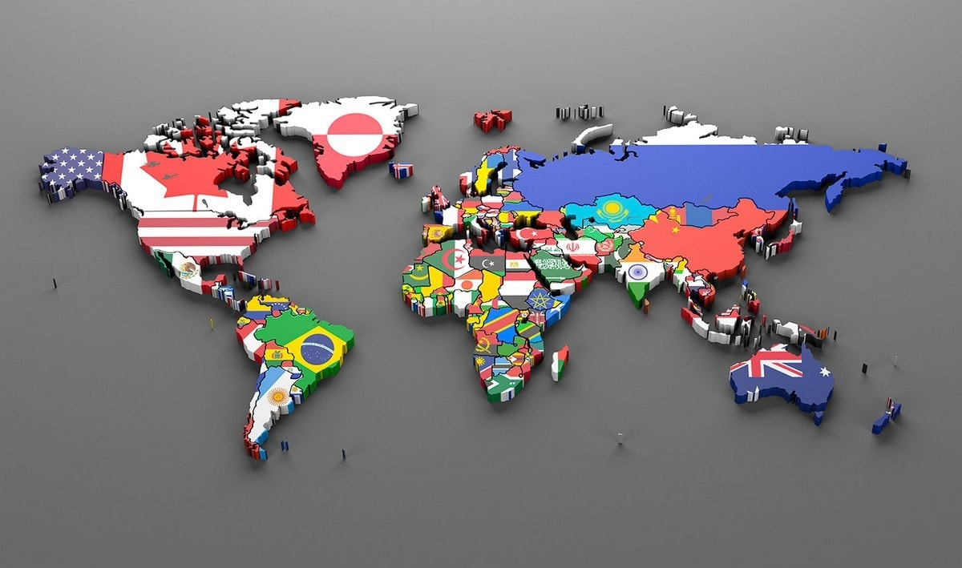
Detailed View of Geographic Variables
Region
Urban, Sub- urban, Rural
City Size
County Size
State Size
Market Density
Climate
Terrain

Slide 14
Demographic
Geographic
Variables for Segmenting
Consumer
Markets
Psychographic

Slide 15

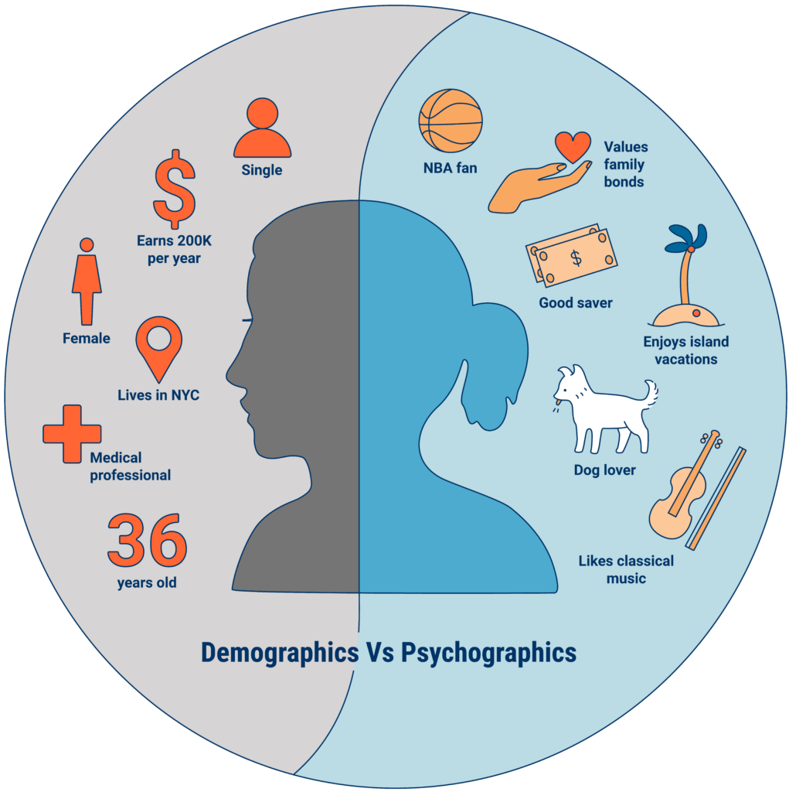
Detailed View of Psychographic Variables
Personality Attributes
Motives
Lifestyles

Slide 16
Demographic
Geographic
Variables for Segmenting
Consumer
Markets
Psychographic
Behavioristic

Slide 17
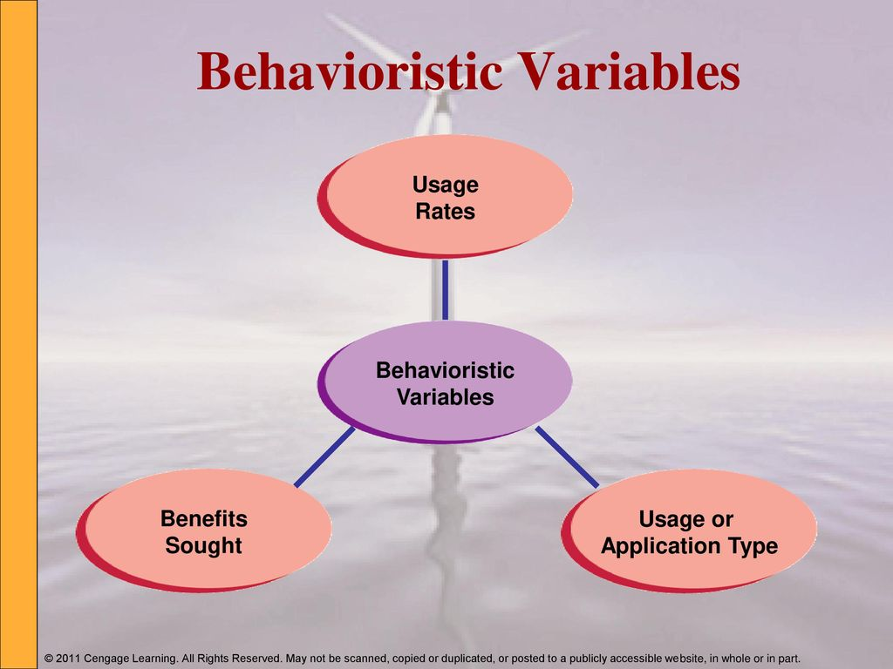
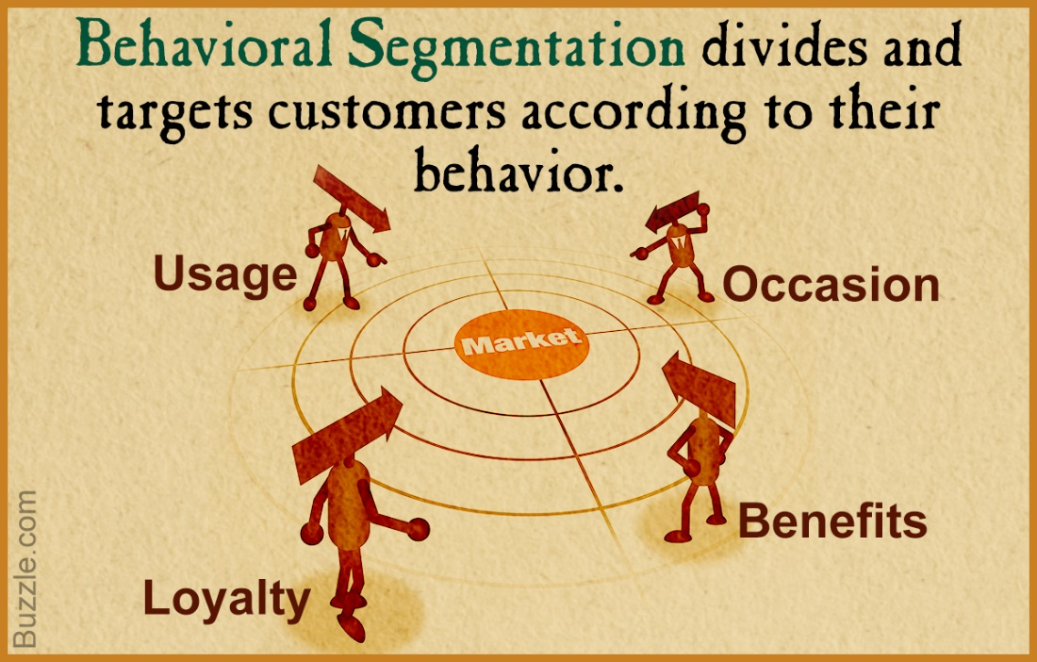
Detailed View of Behavioristic Variables
Volume Usage
End Use
Benefit Expectations
Brand Loyalty
Price Sensitivity

Slide 18
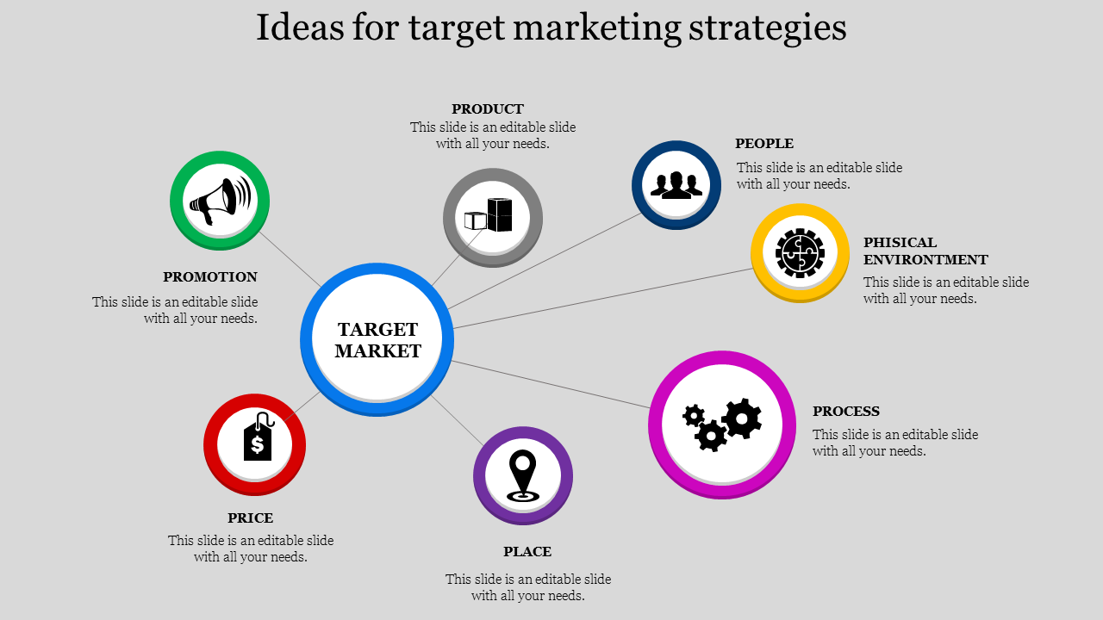
Steps in target marketing
Divide Market into segments; selecting bases for segmentation
Evaluate/appraise segments resulting from above
Select overall targeting strategy
Select specific targets in line with previous step
Develop positioning strategies for each target segment
Develop appropriate marketing mix for each target segment to support positioning strategy

Slide 19
Undifferentiated Strategy
Single Marketing Mix
Organization
Target Market

Slide 20
Concentrated Strategy Through Market Segmentation
Single Marketing Mix
Organization
Target Market

Slide 21
Differentiated Strategy Through Market Segmentation
Marketing Mix 1
Marketing Mix 2
Organization
Target Market

Slide 22
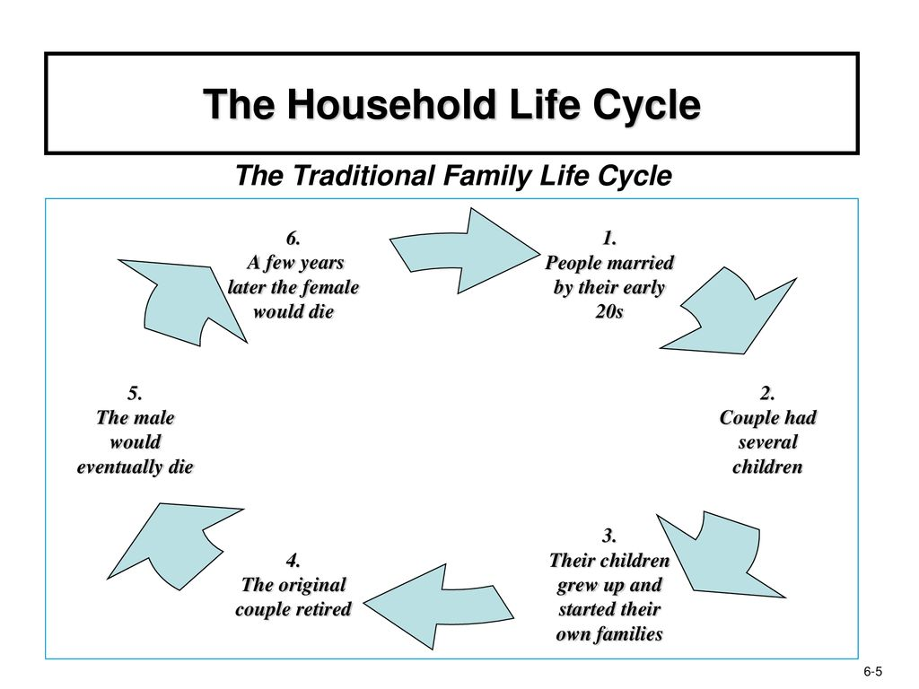
The Family Life Cycle
Traditional Family Life Cycle
Stage I: Bachelorhood
Stage II: Honeymooners
Stage III: Parenthood
Stage IV: Postparenthood
Stage V: Dissolution
Modifications - the Nontraditional FLC

Slide 23
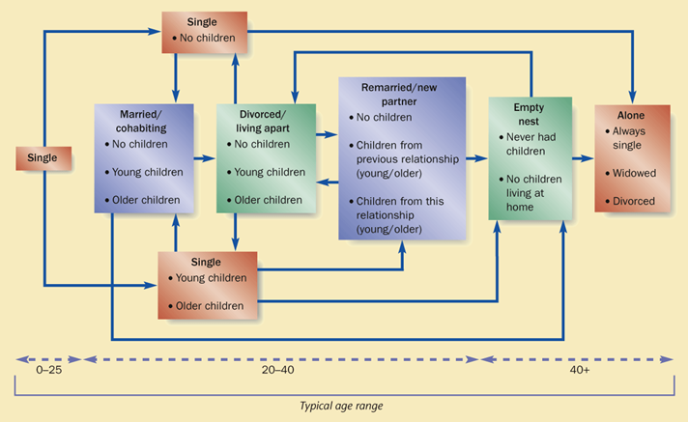
Family Life Cycle
Non-traditional Family Life Cycle

